Slide 1
ISO8583 DAN JSON
Monday, 22 Juni 2020
by :
Ferisa Tri Putri Prestasi

Slide 2


About writer
Mathematics College Student‘16/8th semester ITS Surabaya
Lab Assistant Computation Mathematics ITS Surabaya
Head of Research Development and Knowledge Management Data Science Indonesia Region Jawa Timur
linkedin.com/in/ferisaprestasi
github.com/prestasicode

Slide 3
ISO8583 (International Organization for Standardization)

Slide 4

Glimpse of ISO first,
The International Organization for Standardization (ISO) is an international-standard setting body composed of representatives from various national standard Organization. In contrast to many international organizations, which utilize the British English form of spelling, the ISO uses English with Oxford Spelling as one of its official languages along with French and Russian.
Source : https://en.wikipedia.org/wiki/International_Organization_for_Standardization

Slide 5
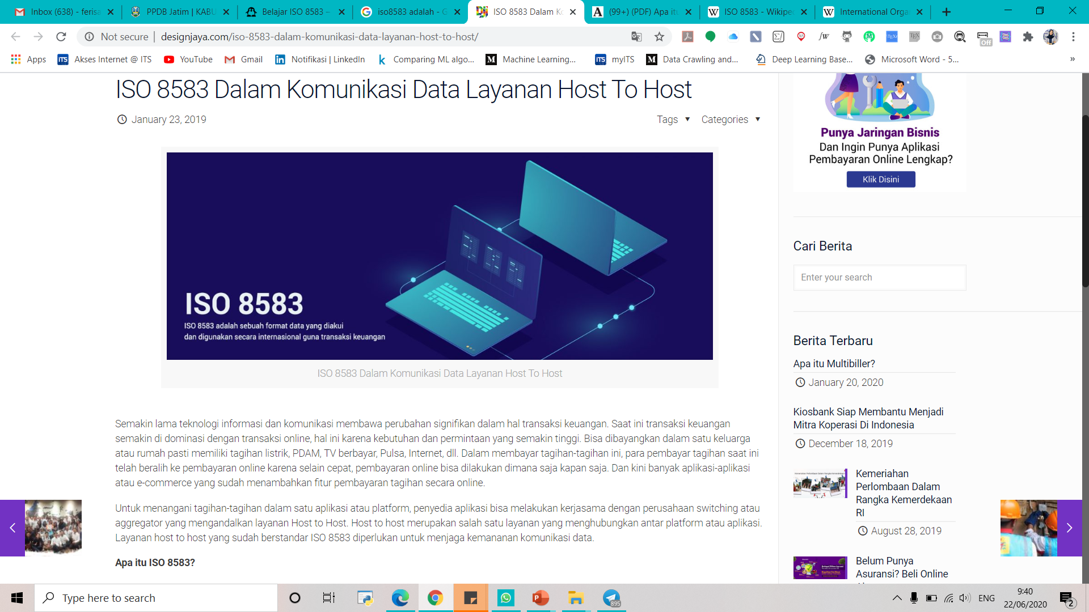
ISO 8583
Why???
Because : financial transaction
ISO 8583 is an international standard for financial transaction card originated
interchange messaging. It is the International Organization for Standardization
standard for systems that exchange electronic transactions initiated
by cardholders using payment cards.
Source : https://en.wikipedia.org/wiki/ISO_8583

Slide 6
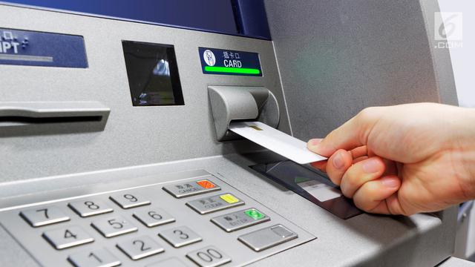

ISO8583 as one of the standard (protocols) various kind of data interchange
Send
Transaction data
Send
Transaction data
Transaction
Process
In the form of
ISO8583
SERVER
Source : https://www.codeproject.com/Articles/100084/Introduction-to-ISO

Slide 7
MESSAGE STRUCTURE OF ISO8583
MESSAGE HEADER
Used as an initial marker of message.
Envelopes the application data and are used for routing and message integrity.
HEADER
MTI
BITMAP
APPLICATION DATA
consist of ISO message including Message Type Indicator (MTI), BIT MAP (indicating which data elements are present) and ISO Data Element (the fields of the message).
MESSAGE TRAILER
Used as a marker for end messages or differentiators between messages.
Envelopes the application data and are used for routing and message integrity.
DATA
ELEMENT
TRAILER
Source : https://www.codeproject.com/Articles/100084/Introduction-to-ISO

Slide 8

Details Component ISO8583
Message Type Indicator
BITMAP

Slide 9
MTI (Message Type Indicator)
1
Message
Version
Message
Class
4 digits
numeric field
(mayor message)
Classifying
Message
Function
Message Origin
Let's discuss MIT one by one >>>>

Slide 10
Message Version
Code | Meaning
0xxx | ISO 8583:1987 version
1xxx | ISO 8583:1993 version
2xxx | Reserved for ISO use
3xxx | Reserved for ISO use
4xxx | Reserved for ISO use
5xxx | Reserved for ISO use
6xxx | Reserved for ISO use
7xxx | Reserved for ISO use
8xxx | Reserved for national use
9xxx | Reserved for private use
“Different versions of the ISO 8583 standard are indicated in the first position of the Message Type Indicator.“
Source : https://www.codeproject.com/Articles/100084/Introduction-to-ISO

Slide 11
Message Class
Code | Meaning | Usage
x0xx | Reserved by ISO
x1xx | Authorization Message | Determine if funds are available, get approval but don’t post to account for reconciliation
x2xx | Financial Message | Determine if funds are available, get approval and post to account for reconciliation
x3xx | File Actions Message | Used for hot-card, TMS and other exchanges
x4xx | Reversal & Chargeback Message | Reversal (x4x0 or x4x1): Reverses the action of a previous authorization Chargeback (x4x2 or x4x3): Charge back a previously cleared financial message
x5xx | Reconciliation Message | Transmits settlement information message
x6xx | Administrative Message | Transmits administrative advice. Often used for failure message (e.g message reject or failure to apply)
x7xx | Fee Collection Message
x8xx | Network Management Message | Used for secure key exchange, logon, echo test, and other network functions
x9xx | Reserved for ISO use
function as a type of message, for example whether it is in the form of requests, responses, advice and others - others. The following is a table for the message function.
Source : https://www.codeproject.com/Articles/100084/Introduction-to-ISO
https://rizkimufrizal.github.io/belajar-iso-8583/

Slide 12
Message Function
has function to defines the purpose of the message to be sent, here is a table for the message class.
Code | Meaning | Notes
xx0x | For a request, requiring approval
xx1x | For a response to a request
xx2x | For an advice of an action that has already been taken, not requiring approval but still requiring a response
xx3x | For a response to an advice
xx4x | For notification
xx5x | Reserved for ISO use
xx6x | Instruction | ISO8583:2003 only
xx7x | Instruction acknowledgement
xx8x | Reserved for ISO use | Some implementation use + acknowledgement
xx9x | Reserved for ISO use | Some implementation use - acknowledgement
Source : https://www.codeproject.com/Articles/100084/Introduction-to-ISO
https://rizkimufrizal.github.io/belajar-iso-8583/

Slide 13
Message Origin
Code | Meaning
xxx0 | Acquirer
xxx1 | Acquirer repeat
xxx2 | Card issuer
xxx3 | Card issuer repeat
xxx4 | Other
xxx5 | Other repeat
xxx6 | Reserved for ISO use
xxx7
xxx8
xxx9
Has a function to define the source of sending data, for example such as the acquirer (the financial institution that issues the buyer's card), the issuer (the financial institution that deals directly with the EDC seller's machine) and others.
Source : https://www.codeproject.com/Articles/100084/Introduction-to-ISO
https://rizkimufrizal.github.io/belajar-iso-8583/

Slide 14
GLIMPSE EXAMPLE OF MTI
1101
have a meaning Authorization Request where :
1 -> ISO 8583 version 1993
1 -> Authorization message
0 -> Request
1 -> Acquirer repeat
example that Responses 0110 artinya Authorization Response
where :
0 -> ISO 8583 version 1987
1 -> Authorization message
1 -> Request response
0 -> Acquirer
0110

Slide 15
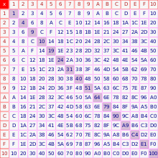
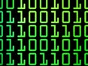
BITMAP
consists of 64 bits numbered from
the left starting with bit 1 (one)
If any ISO message does not support secondary bit map processing, then
the first bit of the bit map is '0'.
2
Each application transaction includes one (1) bit map.
1 (one) as
assigned position
(ACTIVE BINER)
Indexing technique
used in an
ISO 8583 message to indicate which Data Elements are
present.
Indicating
0 (zero) as
absence of a data element in the assigned position
(NON-ACTIVE BINER)
Hexa
decimal
Biner
lookup of the
position of
the data element
to be used.
Change into

Slide 16
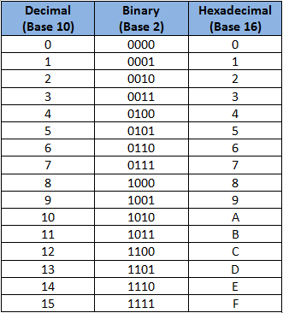
CONVERSION TABLE from Hexadecimal to Biner
EXAMPLE :
F23C449108E080000000000000000021
where the above bitmap consists of 32 characters it can be ascertained that the above bitmap is a
secondary bitmap.
How to change the above hexadecimal to binary is
first break the hexadecimal to 2 digits then convert 1 digit hexadecimal to binary as follows.
Next slide for detail example >>>
A message can contain up to three bitmaps in the latest version of the ISO 8583 standard. The bitmap may be transmitted as 8 bytes
(binary), or sometimes with the 8 bytes unpacked into
16 hexadecimal characters 1-9, A-F (ASCII).

Slide 17
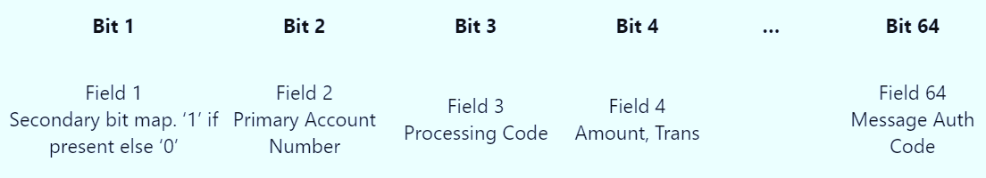
3 TYPES OF BITMAP
1. PRIMARY BITMAP
A message contains at least one bitmap called the Primary Bitmap, indicating the presence of
Data Elements 1 up to 64.
2. SECONDARY BITMAP
A Secondary Bitmap may be located at Data Element one, and hence the first bit in Primary Bitmap tells us whether there is a secondary bitmap or not. The secondary bitmap indicates the presence of
Data Elements 65 up to 128.
TERTIARY BITMAP
The secondary bitmap indicates the presence of Data Elements 129 up to 192.
Source : https://www.codeproject.com/Articles/100084/Introduction-to-ISO

Slide 18
Hexa | Hexa | Biner | Biner
F | 2 | 1111 | 0010
3 | C | 0011 | 1100
4 | 4 | 0100 | 0100
9 | 1 | 1001 | 0001
0 | 8 | 0000 | 1000
E | 0 | 1110 | 0000
8 | 0 | 1000 | 0000
0 | 0 | 0000 | 0000
0 | 0 | 0000 | 0000
0 | 0 | 0000 | 0000
0 | 0 | 0000 | 0000
0 | 0 | 0000 | 0000
0 | 0 | 0000 | 0000
0 | 0 | 0000 | 0000
0 | 0 | 0000 | 0000
2 | 1 | 0010 | 0001
Combine all biner number like this
11110010001111000100010010010001000010001110000010000000000000000000000000000000000000000000000000000000000000000000000000100001
From the binaries above it can be
seen that the all number 1 shows that the active binaries,
the following are the active binaries in position: 1,2,3,4,7,11,12,13,14,18,22,25,28,32,37 , 41.42,43,49,123
and 128.

Slide 19

Data Element
Data Elements are fields carrying the information of the transaction itself.
There are up to 128 Data Elements in the original ISO 8583 (1987) standard, and up to 192 Data Elements in later releases.
Each Data Element has a specified meaning and format.

Slide 20
Data Element Format
ISO-8583 specifies different kind of fields that basically fall in following categories:
Fixed length
Numeric
Alphanumeric
Binary
Variable length
Max-length 99
Numeric
Alphanumeric
Binary
Max-length 999
Numeric
Alphanumeric
Binary
Nested Message

Slide 21
FIELD
TYPE
ATTRIBUTES
Abbreviation | Meaning
a | Alphabetic, including Blanks
n | Numeric Values only
s | Special Characters only
an | Alphanumeric
as | Alphabetic & Special Characters only
ns | Numeric and Special Characters only
ans | Alphabetic, numeric & Special Characters
b | Binary Data
z | Tracks 2 & 3 code set as defined in ISO 7811 & ISO 7813
h | Hex Data
LL, LLL | Length of variable field that follows. ‘LL’ - Two-digit length indicator (1 byte BCD) ‘LLL - 3-digit length indicator (2 bytes BCD)
..17 ..125 | Variable field of up to 17. The ‘..’ is a two-digit length indicator (1 byte BCD) specifying the number of digits defining the length of the variable data to follow. Variable field of up to 125 characters. The ‘…’ is a three-digit length indicator (2 bytes BCD), specifying the number of digits defining the length of the variable data to follow.

Slide 22
# | Name | Value | Hex Value
0 | MTI | 0800 | 08 00
1.a | PRIMARY BITMAP | Indicates presence of secondary bitmap plus fields 3, 11 and 41 | A0 20 00 00 00 80 00 10
1.b | SECONDARY BITMAP | Indicates presence of field 70 | 04 00 00 00 00 00 00 00
3 | PROCESSING CODE | 000000 | 00 00 00
11 | SYSTEM TRACE AUDIT NUMBER | 000001 | 00 00 01
41 | CARD ACCEPTOR TERMINAL IDENTIFICATION | 29110001 | 32 39 31 31 30 30 30 31
60 | RESERVED FOR PRIVATE USE | TEST MESSG | 00 10 54 45 53 54 20 4D 45 53 53 47
70 | NETWORK MANAGEMENT INFORMATION CODE | 301 | 03 01
In above sample, two new fields
#60 and #70 are present.
Here is our message representation:
Message:
0800A020 00000080 00100400 00000000
00000000 00000001 32393131 30303031
00105445 5354204D 45535347 0301
MTI: 0800
Primary bitmap: A0200000 00800010
Secondary bitmap: 04000000 00000000
Field 03: 000000
Field 11: 000001
Field 41: 3239313130303031
(ASCII for "29110001")
Field 60: 0010 54455354204D45535347
(length=10, value="TEST MESSG")
Field 70: 0301
Let's break down this bitmap >>>

Slide 23
PRIMARY BITMAP
RESULT BITMAP EXPLANATION
SECONDARY BITMAP
Byte | Hex Value | Bit Value | Field #
0 | A0 | 1010 0000 | Secondary bitmap present plus #3
1 | 20 | 0010 0000 | 11
2 | 00 | 0000 0000
3 | 00 | 0000 0000
4 | 00 | 0000 0000
5 | 80 | 1000 0000 | 41
6 | 00 | 0000 0000
7 | 10 | 0001 0000 | 60
Byte | Hex Value | Bit Value | Field #
0 | 04 | 0000 0100 | 70
1 | 00 | 0000 0000
2 | 00 | 0000 0000
3 | 00 | 0000 0000
4 | 00 | 0000 0000
5 | 80 | 0000 0000
6 | 00 | 0000 0000
7 | 00 | 0000 0000

Slide 24
JSON (JavaScript Object Notation)

Slide 25
Glimpse of JSON
But, wait.. What is metadata? Next slide >>>
Accessing Metadata is often possible through services offered by the provider and can be retrieved in a structured format that could include raw text, XML (eXtensible Markup Language, or in this example JSON.
JavaScript Object Notation is an open standard file format, and data saving and interchange format, that uses human-readable text to store and transmit data objects consisting of attribute-value pairs and array data types (or any other serializable value).
JSON is programming language independent (JavaScript is not required to use it).
JSON is based on the object literal notation of JavaScript (emphasis on the word “notation”).
JSON represents data in a way that is friendly to universal programming concepts.
Source : https://en.wikipedia.org/wiki/JSON

Slide 26
Glimpse of Meta-data
Keyword (Additional Slide)
Meta-data is information about the physical data, technical and business processes, data rules and constraints, and logical and physical structures of the data, as used by an organization.
Meta-data is a set of data that describes and gives information about other data.
Source : Mosley, Brackett, Early, & Henderson, 2010; Oxford Dictionaries

Slide 27
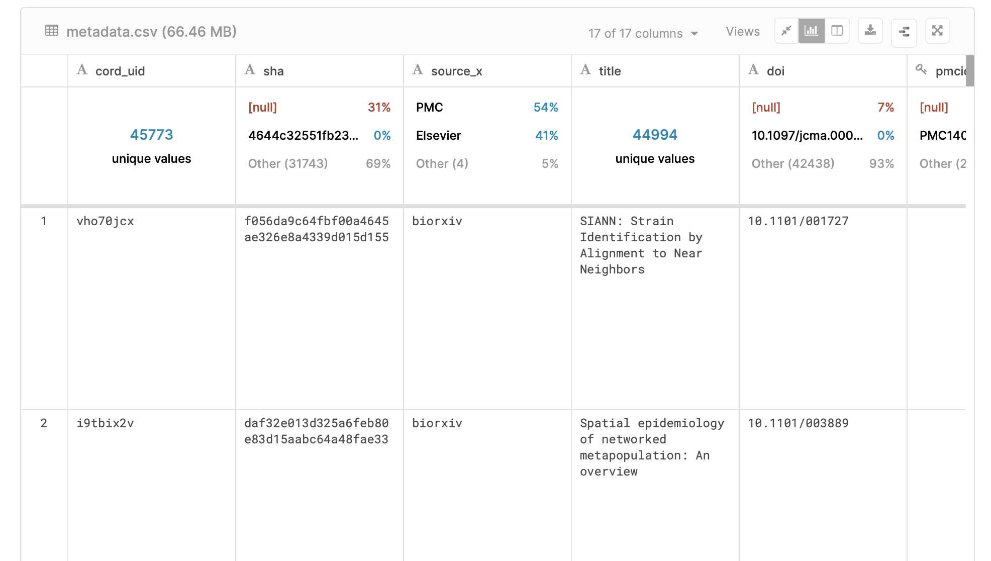
When developing a database structure for an information system,
there needs to be a metadata schema.

Slide 28
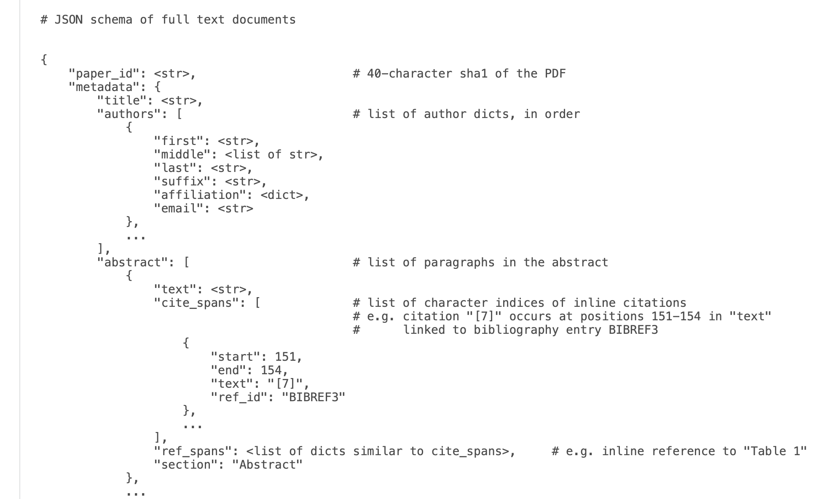
JSON Structure
JSON Structure
Opening sign
Comma for separated more than one data
Closing sign
Value
Key
Colon sign for separated between key and value
Marker at the end before closing

Slide 29
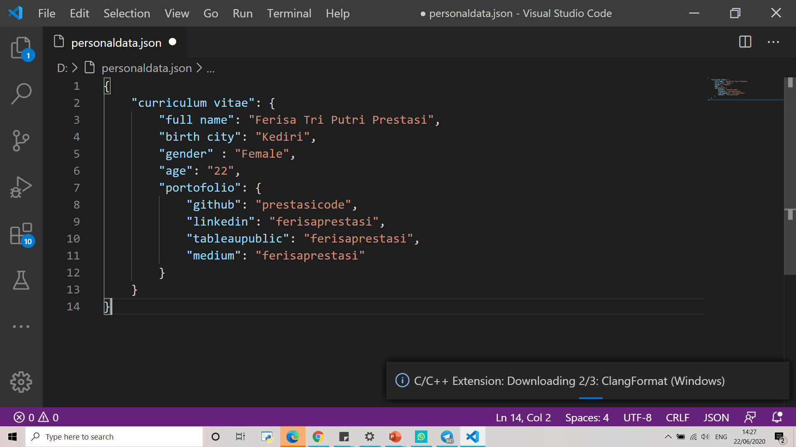
Example of JSON

Slide 30
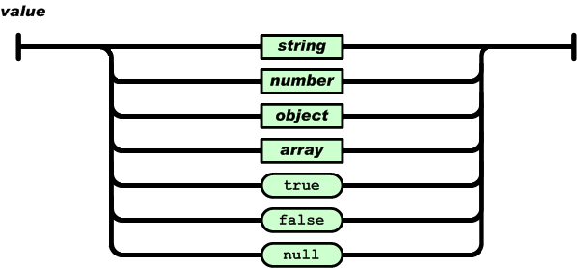
JSON Compatible Value Format
Source : https://www.petanikode.com/json-pemula/

Slide 31
Thank you
Ferisa Tri Putri Prestasi
06111640000031
ferisatri04@gmail.com

